Slide 1

Smartphone Penetration Analysis

Slide 2
Project Overview
Objective: Scrape and analyze smartphone penetration data from Wikipedia
Tasks : Web scraping, data cleaning, KPIs, and visual insights
Tools : Python, BeautifulSoup, Pandas, Seaborn, Matplotlib

Slide 3
Web Scraping Process
Fetched Wikipedia page using Requests
Added custom User-Agent header to avoid HTTP 403 erro
Ensured stable connection with proper error handling
Verified the status code (200 OK) before parsing
Parsed HTML with BeautifulSoup.
Loaded the raw HTML into a structured, searchable format
Located <table> tags containing “wikitable” class
Cleaned and filtered the HTML elements before extracting data
Extracted target table using pandas.read_html().
Converted HTML table directly into a pandas DataFrame
Automatically handled rows, columns, numeric formatting
Selected the correct table among multiple tables on the page

Slide 4
Data Cleaning
Removed '%' and 'M' symbols.
Cleaned percentage values for numerical operations
Standardized population and user counts by removing “million” suffix
Ensured consistent formatting across all rows
Converted population & user counts to numeric
Converted text values (e.g., "1,430M") into float numbers
Enabled accurate mathematical operations, comparisons, and KPI calculations
Handled missing or inconsistent data where necessary
Created penetration ranges using pd.cut().
Grouped countries into logical bins (0–30%, 30–50%, 50–70%, 70–90%, 90–100%)
Allowed clearer segmentation and visual comparison
Helped generate insights such as which range most countries fall into

Slide 5
Key Performance Indicators (KPIs)
Average, Median & Standard Deviation
Highest & Lowest Penetration Countries
Range of Penetration
Interquartile Range (IQR)
Weighted Penetration (Population-Adjusted)
Share of Countries ≥70% Penetration
Top-3 vs Bottom-3 Penetration
Skewness Indicator (Median – Mean)
Countries in Each Penetration Range
Most Common Penetration Band

Slide 6
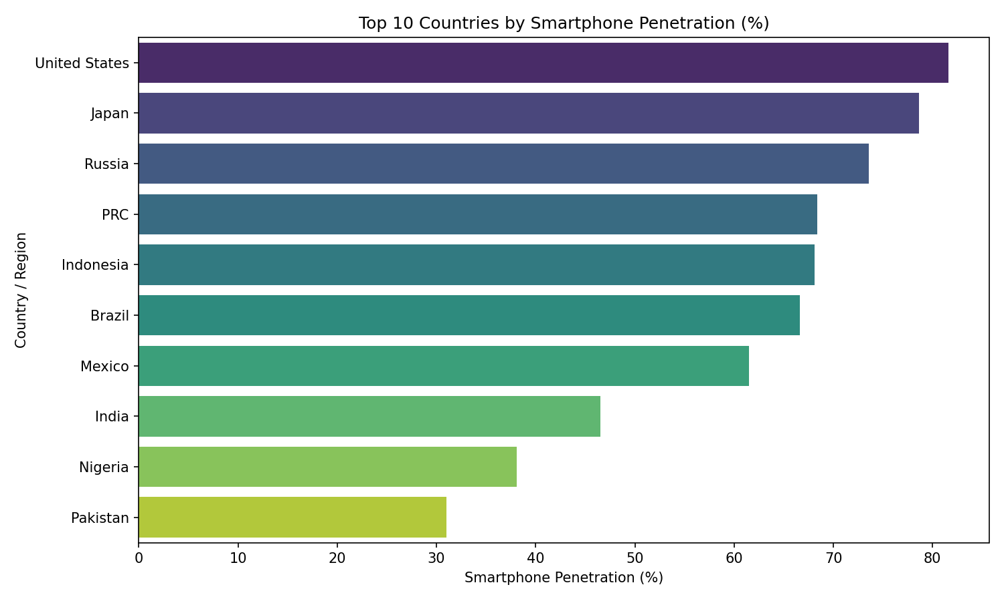
Top 10 Most Populated Countries
Purpose:
To visually compare smartphone penetration levels across the top 10 countries.
To identify which nations lead in digital adoption and mobile connectivity.
To highlight global disparities in smartphone accessibility.
To provide a quick, ranked overview of countries with the highest smartphone usage.

Slide 7
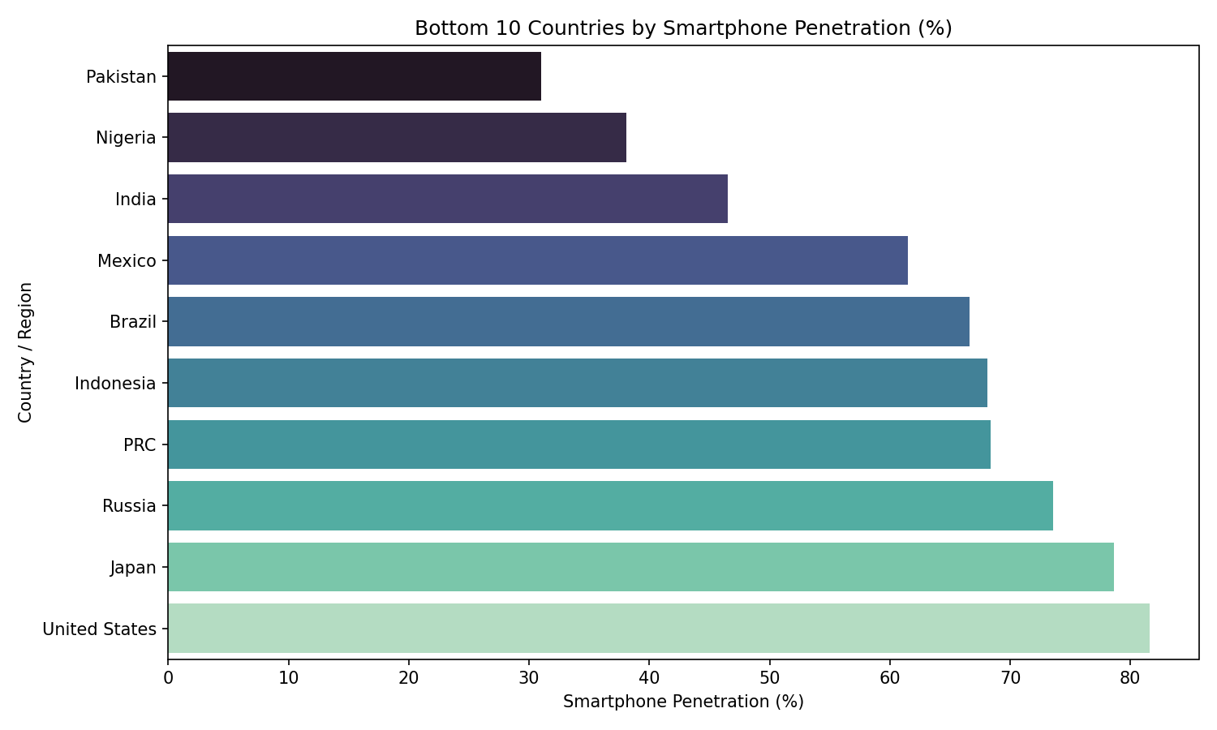
Bottom 10 Countries by Smartphone Penetration
Purpose:
To highlight countries with the lowest smartphone adoption levels.
To identify regions where digital connectivity is still limited.
To help understand global inequalities in smartphone access.
To support discussion on why adoption is low (economy, infrastructure, policy, etc.).

Slide 8
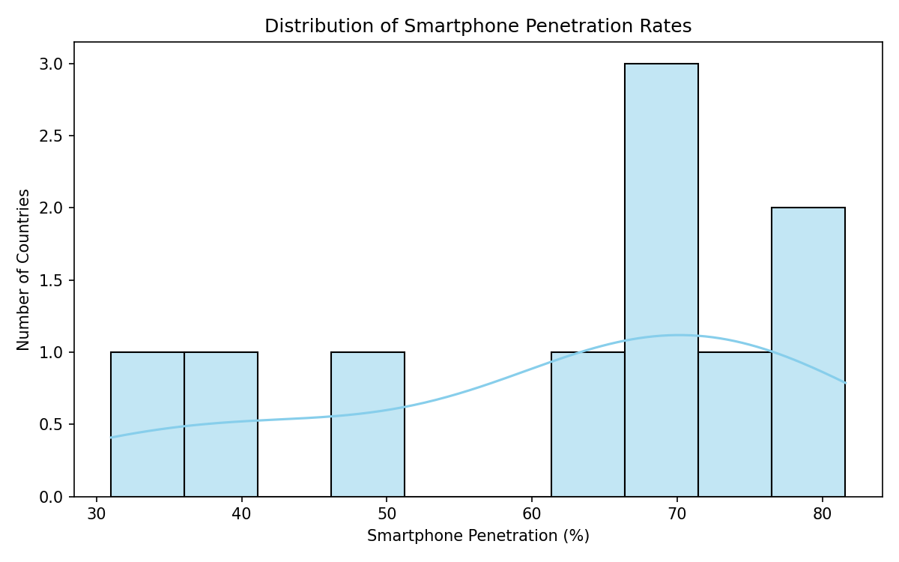
Distribution of Smartphone Penetration Rates
Purpose:
To visualize how smartphone penetration is distributed across countries.
To identify clusters and patterns in adoption rates.
To understand variability and inequality in smartphone access.
To check for skewness or outliers.

Slide 9
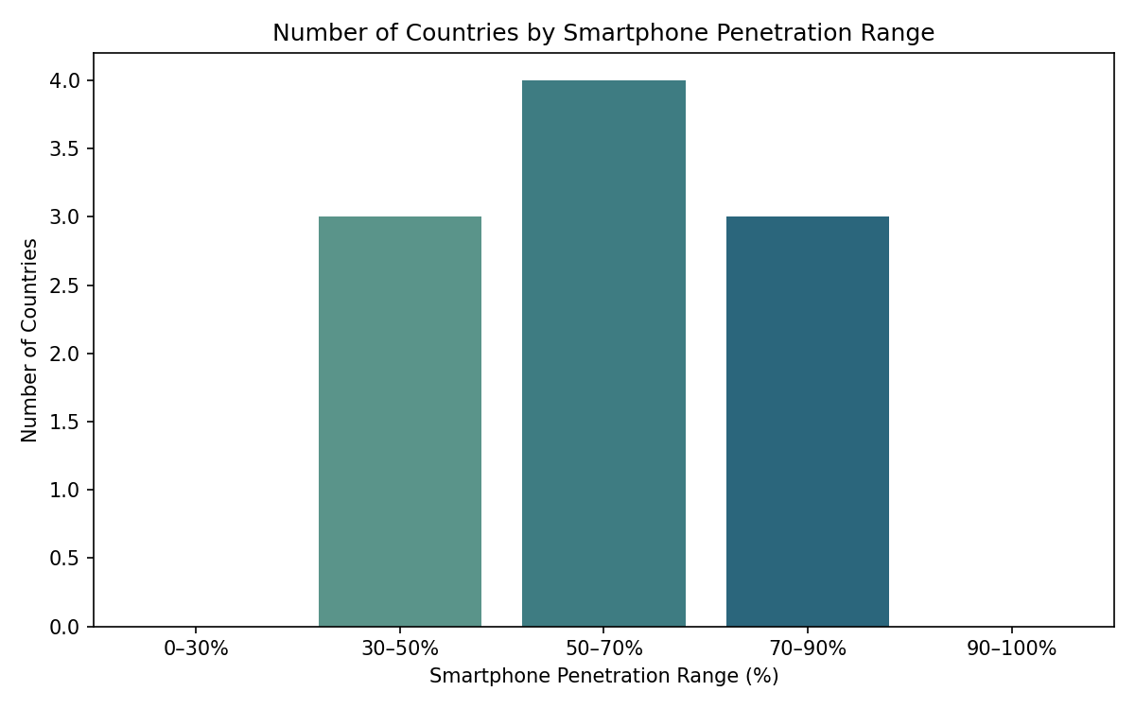
Penetration Range Groups
Purpose:
To categorize countries into penetration brackets.
To quickly identify which adoption tier is most common
To evaluate distribution across penetration levels
To highlight gaps in extreme ranges
To support segmentation-based analysis

Slide 10
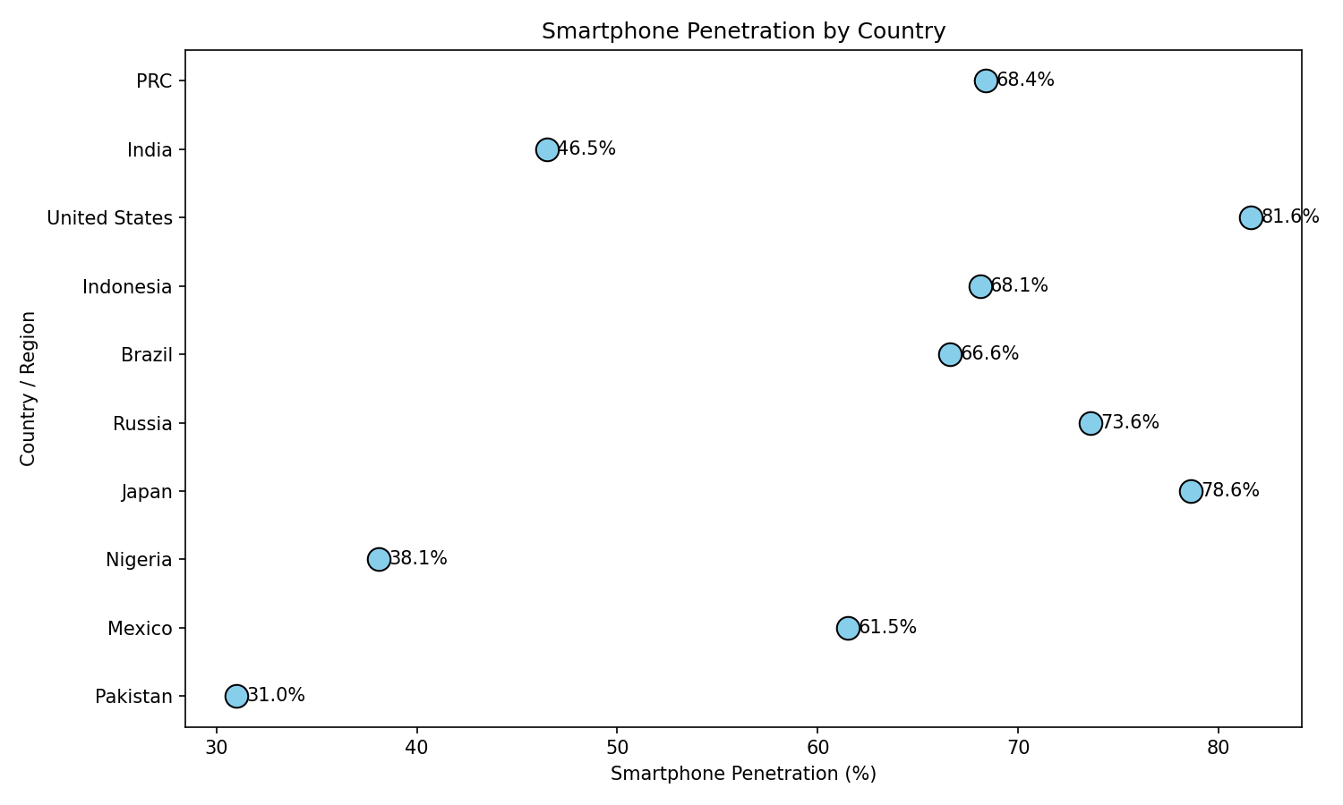
Smartphone Penetration by Country
Purpose:
To compare smartphone penetration across individual countries.
To highlight outliers and extreme performers.
To visualize variation within the dataset.
To understand regional digital maturity.
To support ranking and target prioritization

Slide 11
Conclusion:
Successfully scraped, cleaned, and analyzed smartphone penetration data.
Visualizations revealed clear differences in adoption across countries.
High-penetration countries (e.g., U.S., Japan) show strong digital maturity
Low-penetration countries (e.g., Pakistan, Nigeria) show high growth potential.
Most countries fall in the 50–70% range, indicating rising global connectivity.
Project demonstrates effective use of web scraping, data processing, and EDA for real-world insights.

